Slide 1
iSee
Accessible Gaze-Based Reading for the iPhone
Beverly Yip | Josephine Odusanya | Yi Wang
12/09/2025
Notes:
Bev
Hi everyone, we're iSee. Our project focuses on creating accessible gaze-based technology for iPhone users with limited mobility. I'm Beverly and I lead software research and development. Yi focuses on user research and interaction design, and Jo on hardware.

Slide 2
Overview
00
Understanding the User and the Problem
Notes:
Bev
Let me start by introducing our client.

Slide 3
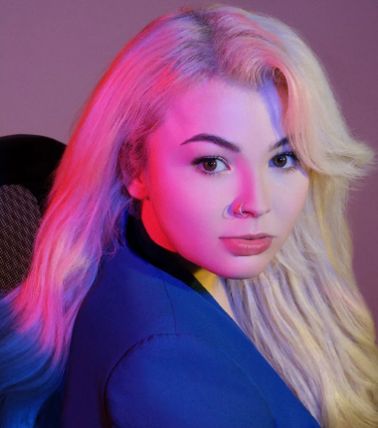
Jessica Frew
Model, Actress & Disability Advocate
Born with cerebral palsy, resulting in significant limitations to upper-body mobility
Has been using eye gaze technology as her primary communication method since age 9
Needs reliable eye tracking that works seamlessly across different environments and settings
Years of experience with eye gaze systems, but struggles to find a solution balancing portability with precision
Notes:
Bev
Meet Jessica Frew—a model, actress, and disability advocate born with cerebral palsy that limits her upper-body mobility. Since age 9, she's used eye gaze technology to communicate and control devices. Jessica leads an incredibly active life, but struggles to find assistive technology that balances portability with precision.

Slide 4
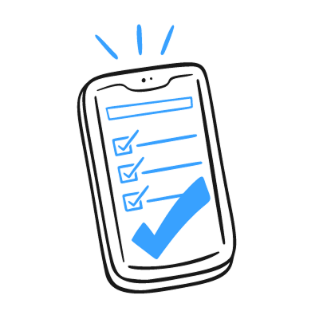
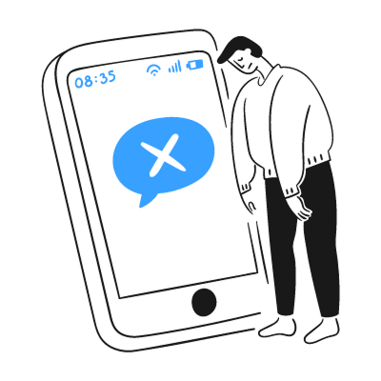
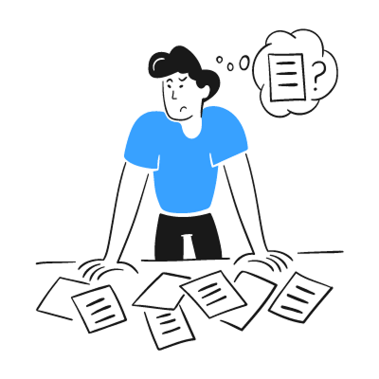

The Problem
The Need
Jessica requires a mobile eye gaze solution that provides desktop-level precision and reliability.
Current iPhone Solutions Fall Short
iPhone's built-in eye gaze system has poor tracking accuracy during actual use, making communication and control impossible.
The Gap
No existing solution bridges the gap between mobile portability and professional-grade eye tracking accuracy.
Notes:
Bev
Here's the problem: Jessica needs mobile eye gaze with desktop-level precision. The iPhone's built-in eye gaze has terrible tracking accuracy—making it essentially useless. Desktop solutions like Tobii work great, but they're bulky and impractical for mobile use. No existing solution bridges this gap.

Slide 5

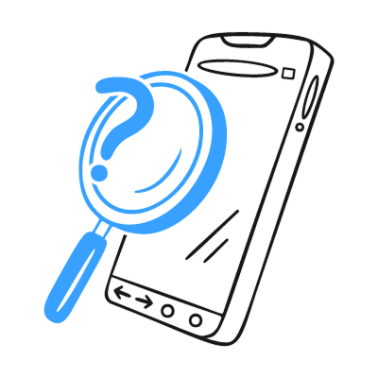
Sub-Problems
Icon Size & Screen Real Estate
Environmental Lighting Challenges
Mobile icons and interactive elements too small for accurate eye gaze selection
Densely packed screens make reliable control frustrating or impossible
Current systems fail in bright sunlight and dim lighting
Direct sunlight washes out tracking; shadows create blind spots
Notes:
Bev
We've identified two technical barriers. First, icons are too small—densely packed mobile screens make accurate selection impossible. Second, lighting challenges—current systems fail in sunlight, dim lighting, or changing conditions, losing calibration mid-use.

Slide 6
Central Question
Can we create a phone-compatible eye tracker that addresses precision and lighting limitations through both hardware innovation and optimized interface design?
Notes:
Bev
Our project aims to answer: Can we bridge the gap between mobile portability and professional-grade eye tracking by addressing both hardware limitations and interface design?
Our approach consists of two parts — a physical hardware prototype to address lighting challenges, and interactive Figma wireframes with enlarged icons and optimized interfaces, plus a web prototype to validate UX concepts.
To ground our design in real user needs, we began with comprehensive research. Yi will now walk us through our research findings.

Slide 7
Research
01
Product Research, User Research
Notes:
Yi: Thanks Bev. I’ll begin with our research.

Slide 8
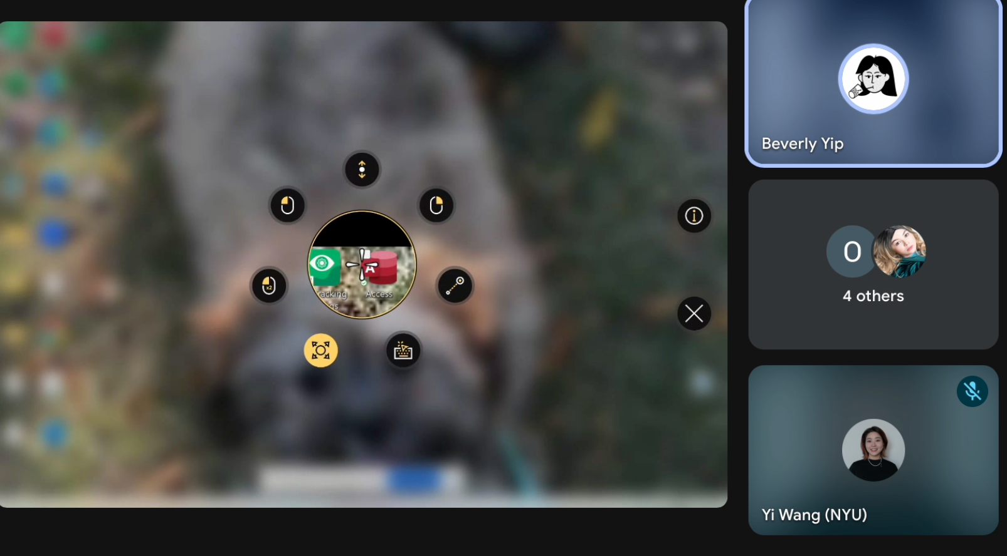
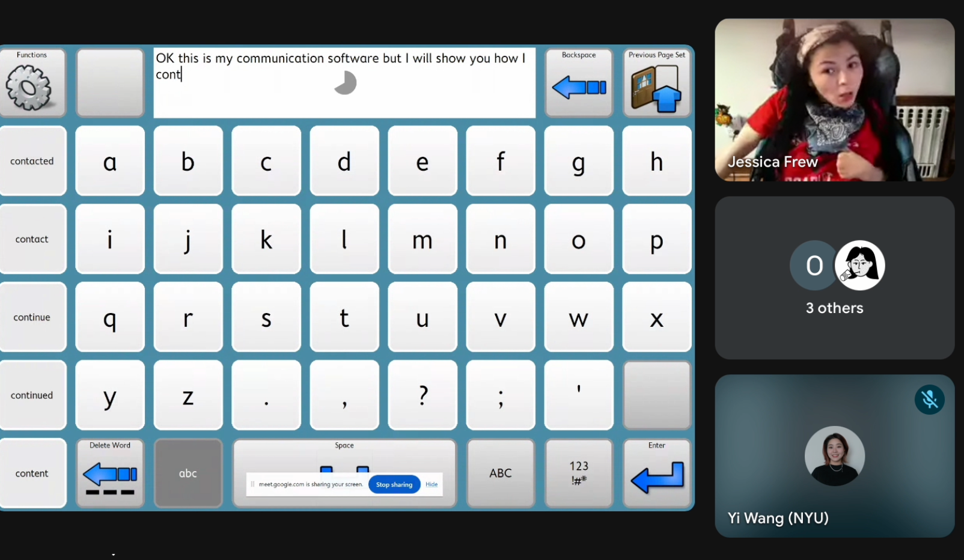
Phase 1: User Centered Research
Meet with User
Observed how she uses her eye-tracking device
Saw calibration issues in bright light
Noticed difficulty selecting small icons
Identified eye fatigue from precise targeting
Collected her early concerns and needs
Notes:
Yi: Our first phase focused on user-centered insights, and you can see two images from our session with Jessica. One shows her eye-tracking control menu, a circular magnifier with tiny icons that appear when she focuses her gaze. The other shows her using a communication keyboard during a video call, typing entirely with her eyes. Meeting her grounded our project in reality. We saw challenges that rarely show up in documentation: calibration slipping under bright light, the struggle of selecting small icons, and the eye fatigue that builds with prolonged typing. She even shared her own idea for an iPhone setup connected through the bottom port.

Slide 9
User Flow
Actions/Thoughts
Pain Points
Design Opportunity
Follows calibration dots with eyes
Hard to calibrate under bright light/ reflections
Simplify Calibration
Use gaze to select icons, scroll, and type
Small icons require precision
Enlarge hit zone
overexposure
Sunlight interferes
Develop adaptive brightness or hybrid sensing(IR-Camera)
Eye tracking falls
Notes:
Yi: We mapped a simple user flow showed on this slide to visualize how eye-only navigation moves through selecting, scrolling, and confirming.

Slide 10
Phase 2: Competitive Analysis
Tobii
PCEye
Industry leader in assistive communication; accurate gaze control; integrates with AAC software
Expensive; limited outdoor performance; bulky setup
Portable eye tracker for Windows; plug-and-play usability
Needs controlled lighting; not optimized for facial occlusion or glasses
more…
Smart Eye, Varjo, Novasight, Omnivision, iMotions
Notes:
Yi: In phase two, we conducted a competitive analysis of systems like Tobii and PCEye. They’re reliable, but still face issues with outdoor lighting, calibration precision, and long-term comfort.

Slide 11
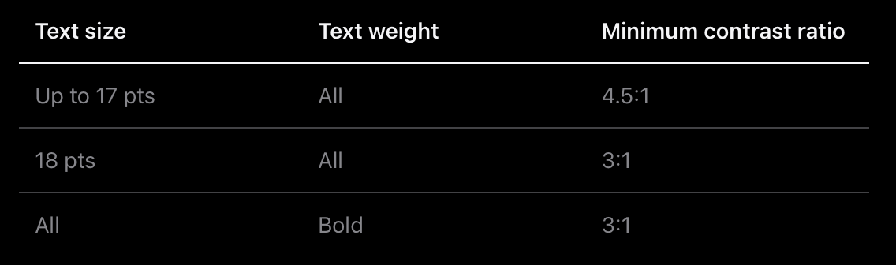
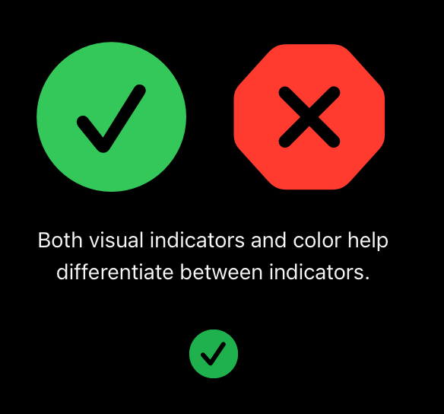
Phase 3: Deep Research
Key Points
Larger, easier-to-hit icons
Clearer feedback
Less effort when moving through screens
WCAG contrast table
Notes:
Yi: Phase three was a deeper dive into Jessica’s specific concerns: larger icons, clearer feedback before selection, and reduced effort across screens. At the top of this slide is a WCAG contrast chart, paired with green check and red X icons that show how color and shape improve clarity.

Slide 12
Testing High vs Low contrast
Element Type | Minimum Contrast | Recommended (Enhanced)
Normal text | ≥ 4.5 : 1 | 7 : 1
Large text (≥18 pt) | ≥ 3 : 1 | 7 : 1
Icons / non-text graphics | ≥ 3 : 1 | Ideally 7 : 1
Findings:
High contrast (7:1) made gaze selection more accurate, while low contrast (3:1) under bright light increased mis-selections, especially when paired with small icons.
Notes:
Yi: We also tested high versus low contrast with the table shown on the slide. High contrast around seven-to-one significantly improved accuracy, while low contrast around three-to-one, especially in bright environments led to more mis-selections.Together, these phases created a foundation shaped not only by research but by lived experience, revealing what users truly need to feel confident and comfortable with eye-tracking.I’ll now hand it to Jo for our prototype design.

Slide 13
Physical Prototype
02
The Hardware
Notes:
Jo

Slide 14
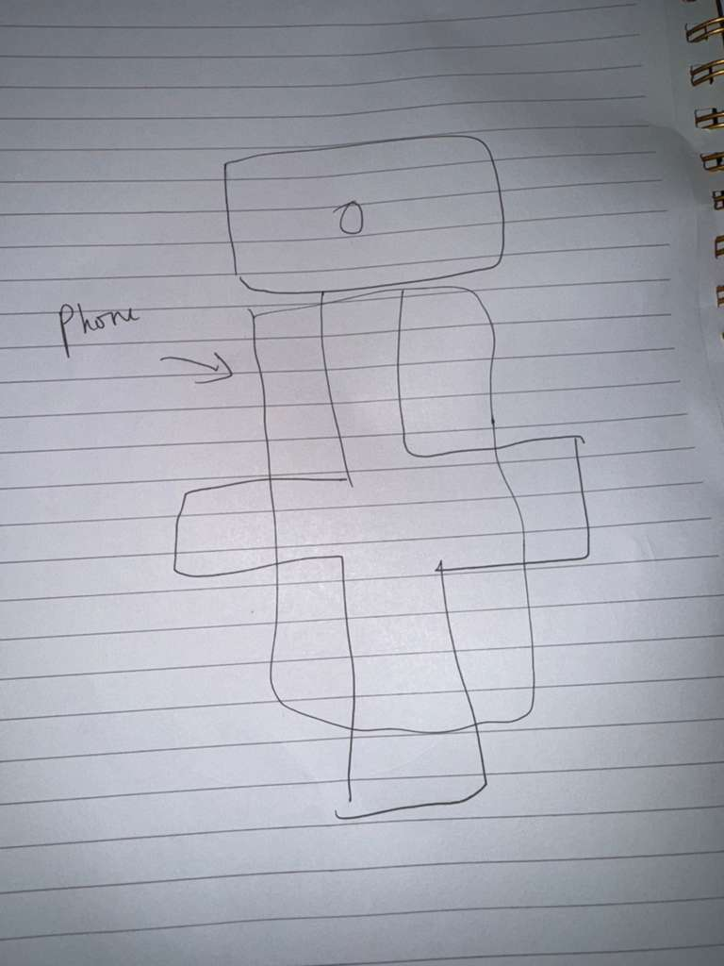
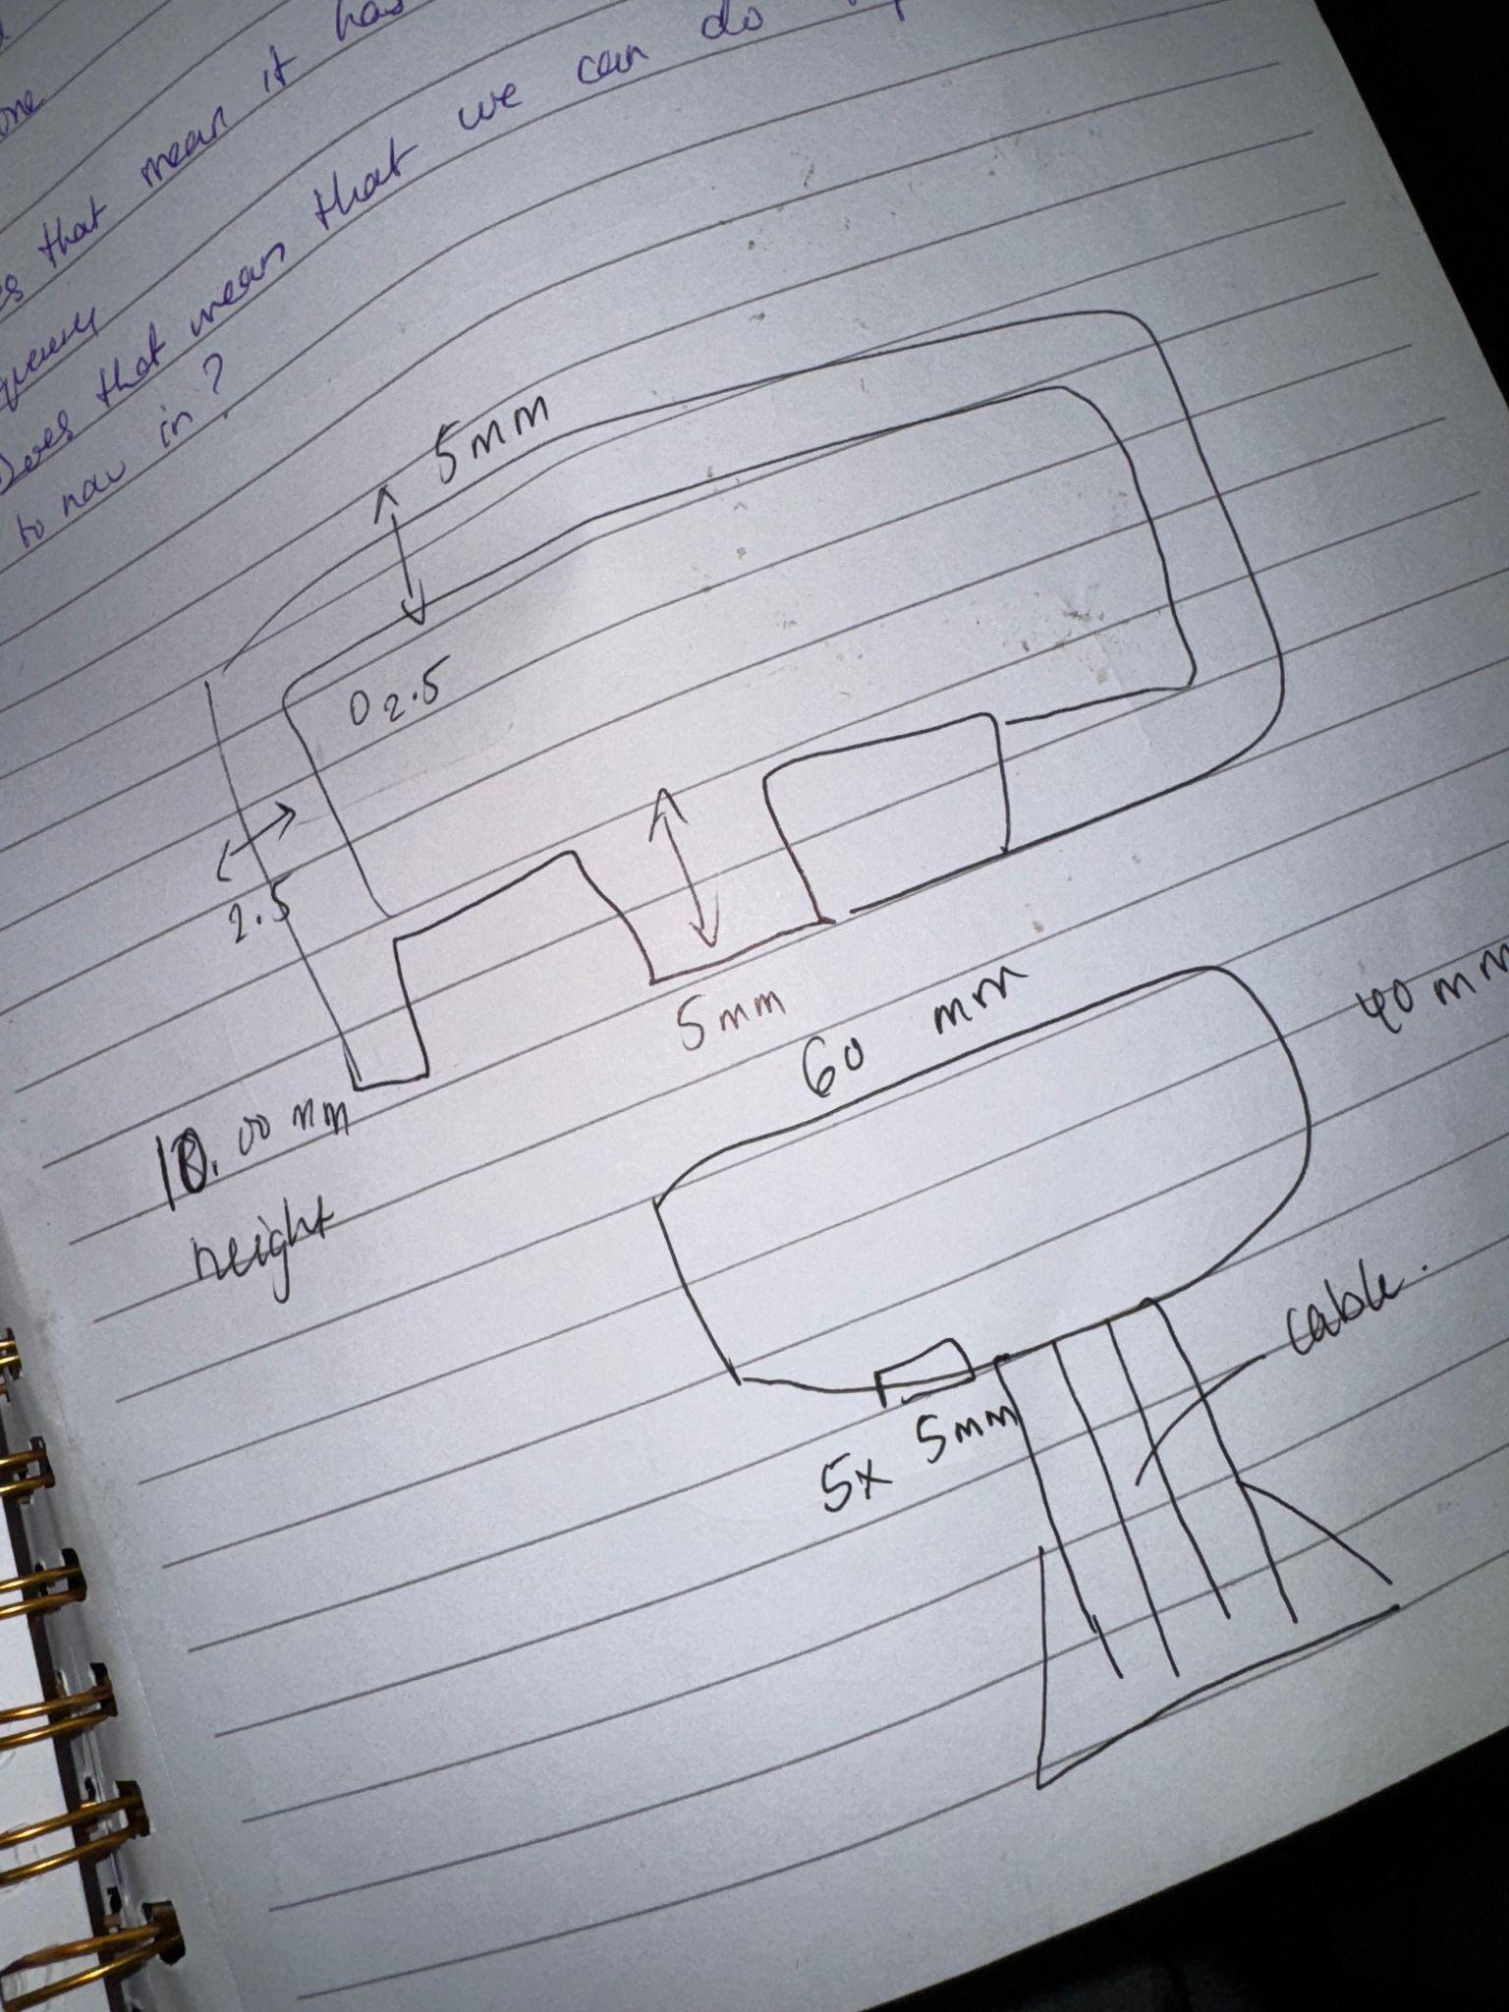
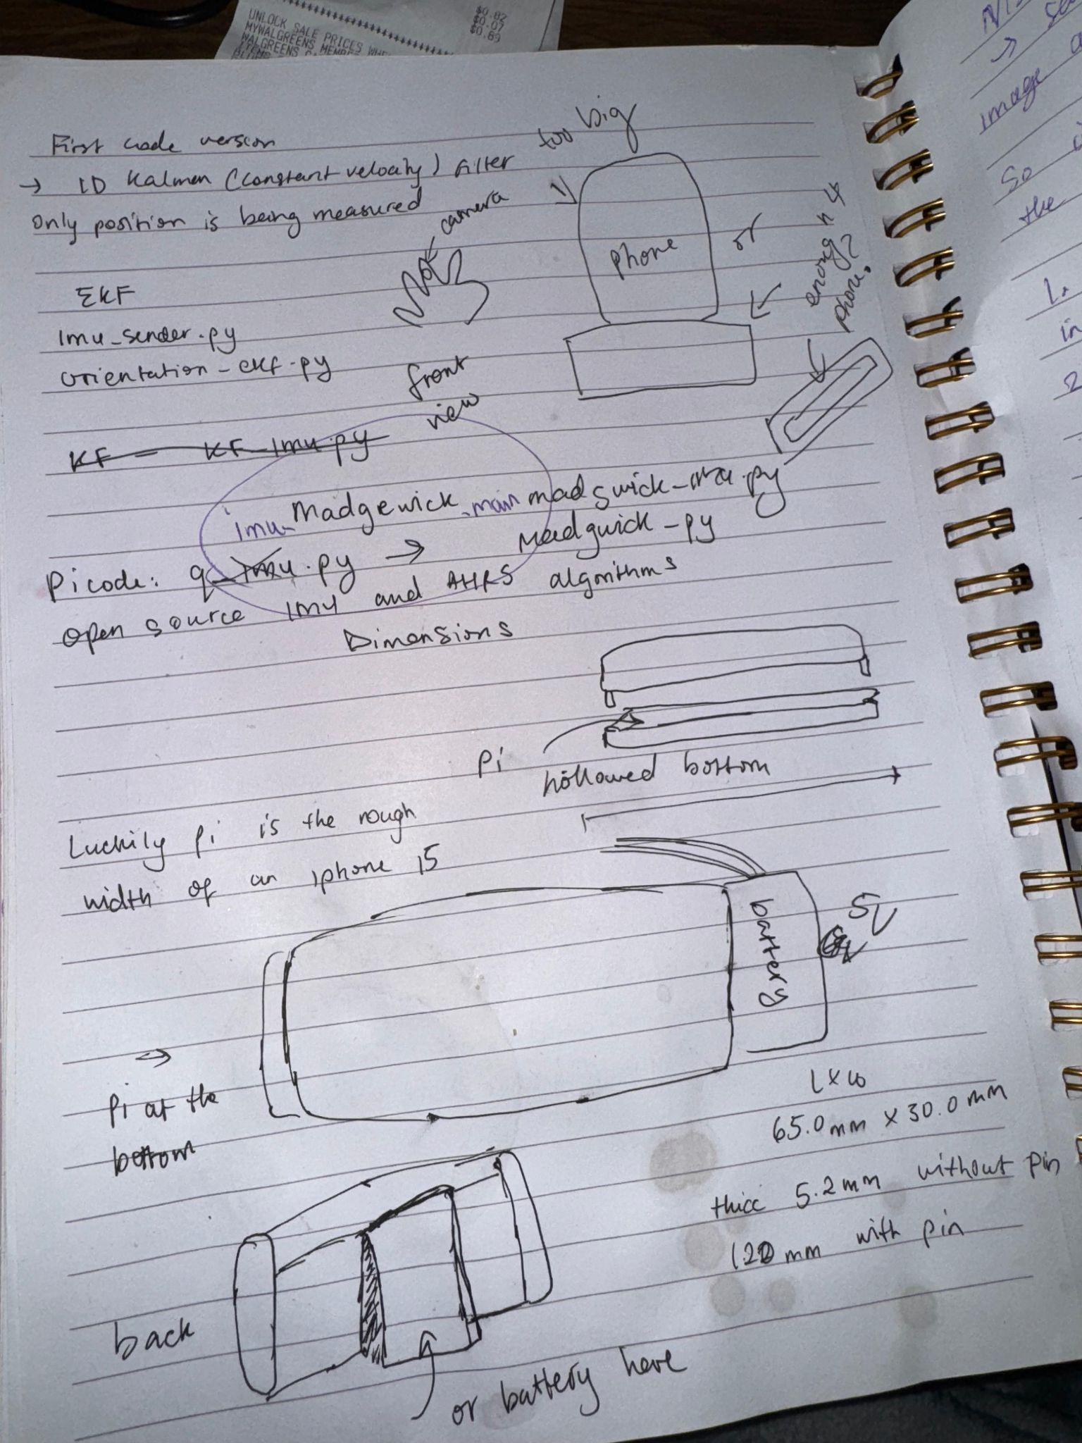
Phase 1: Design Ideation and Sketching
Initial challenge: track eye movement with minimal hardware
Explored different camera positions
Considered glare issues and outdoor use.
Early sketches included:
Camera + stand setup
Pi Zero enclosure footprints
Lens hood concepts
Battery placement
Goal: small, stable, repeatable geometry
Notes:
Jo

Slide 15
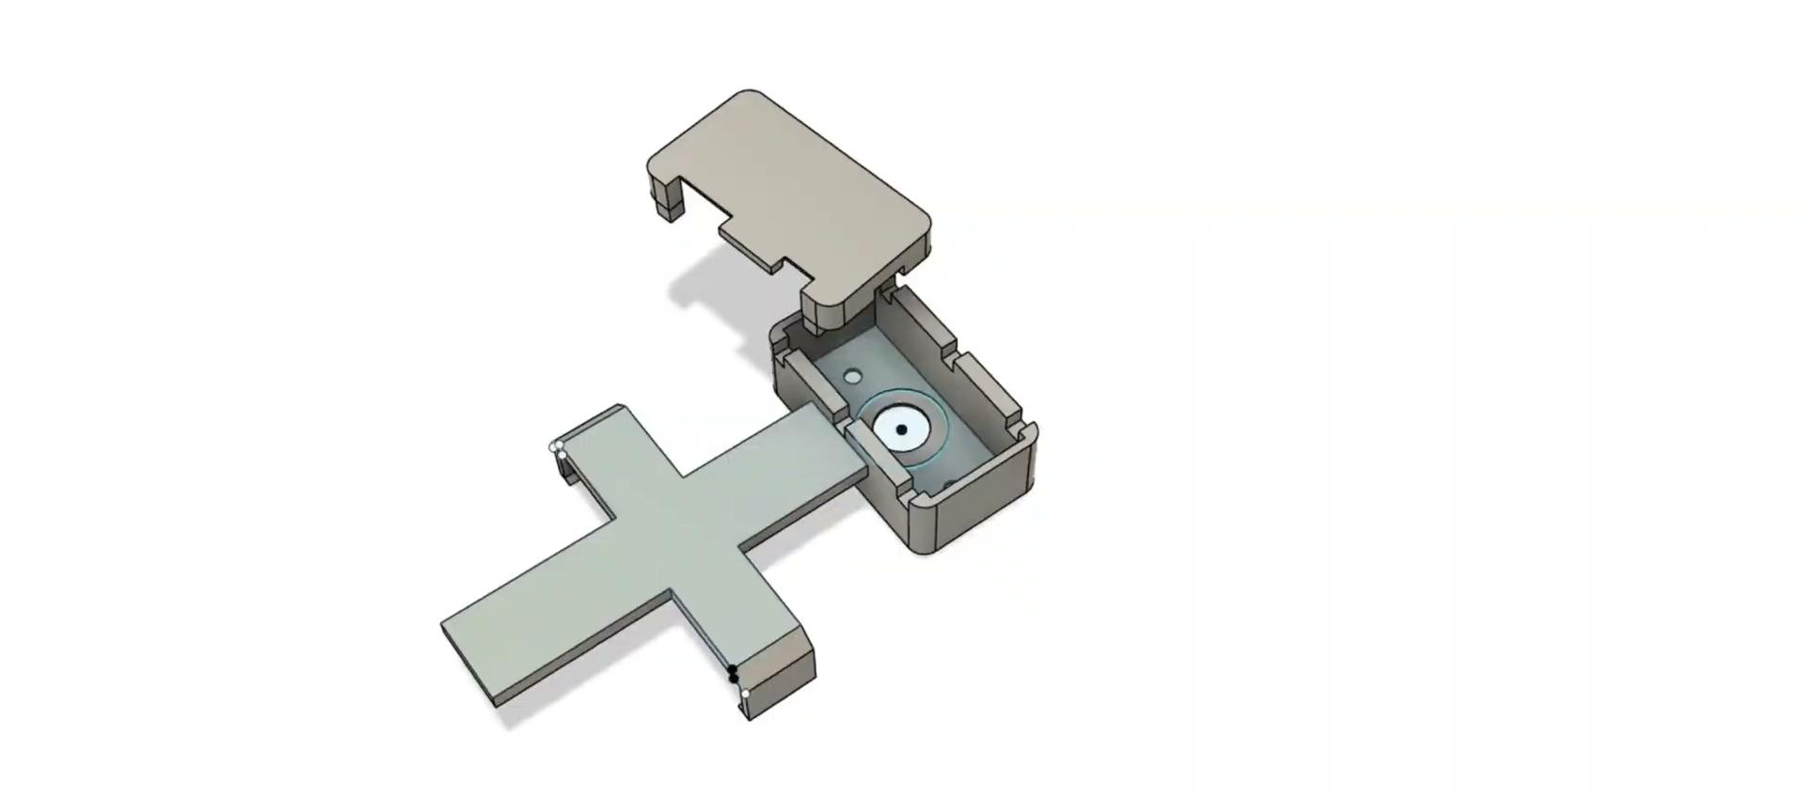
Phase 2: Hardware Assembly
Components
Pi Zero + USB camera setup
OTG adapter + power management
Temporary rig for testing camera angles
Custom enclosure sketches Stand mechanism for stable positioning
Notes:
Jo

Slide 16
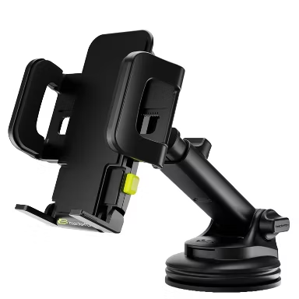
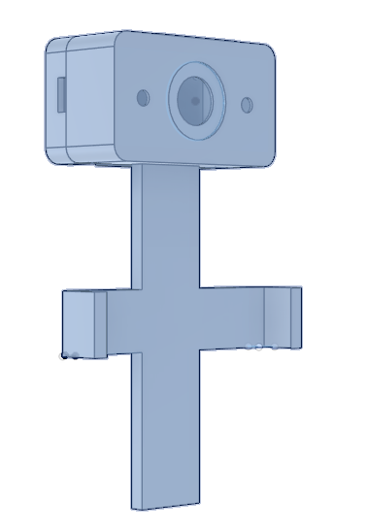
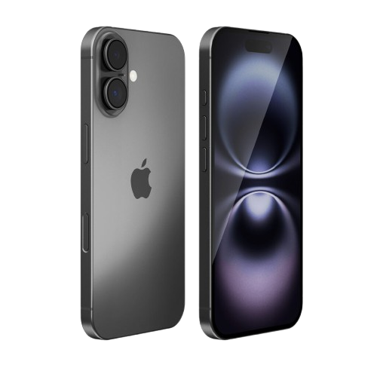
Phase 2: Prototype
Constructed a physical prototype to explore camera placement and alignment.
Evaluated how the camera interacts with the user's natural posture.
Identified mechanical constraints for future enclosure design.
This mockup informed decisions about mounting height, lens orientation, and potential housing components.
Notes:
Jo

Slide 17
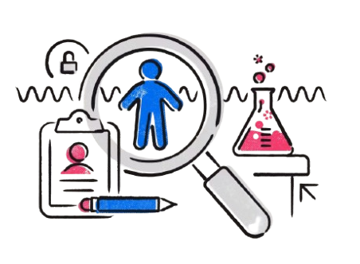
Phase 3: Steps to Initiate User Testing
IRB Requirements & Ethical Preparation
Preparation includes drafting:
A study purpose statement
Participant consent forms
Data-handling and privacy plans
A risk/benefit assessment
IRB approval ensures participant safety, data security, and ethical compliance.
Notes:
Jo

Slide 18
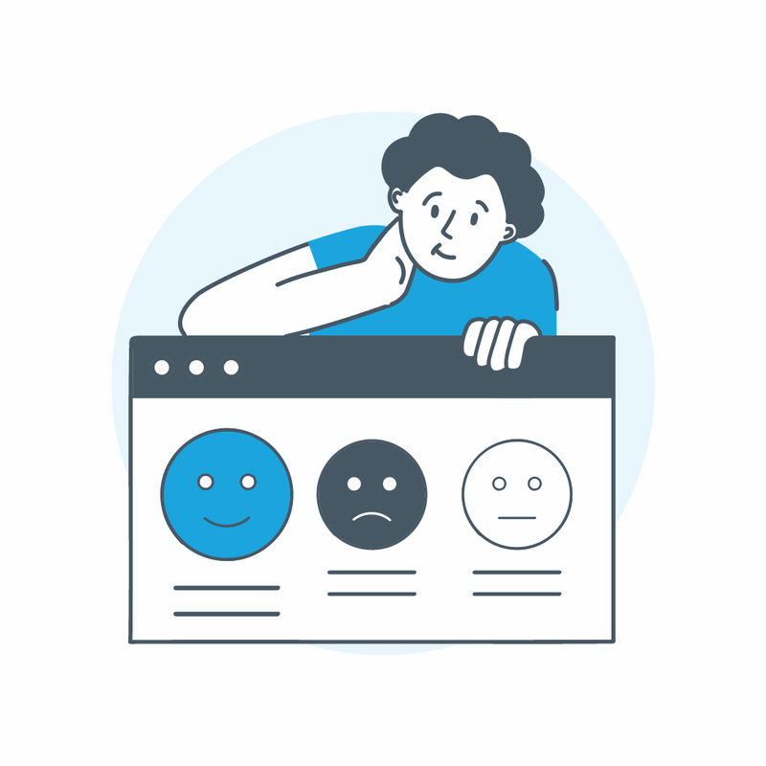
Phase 3: Steps to Initiate User Testing
Post IRB
Recruit a small, diverse group of participants
Run controlled sessions to:
Validate tracking stability
Evaluate comfort and usability
Observe how well the camera captures the eye during natural movement
Document all findings to inform future iterations of hardware, optics, and software.
Notes:
Jo

Slide 19
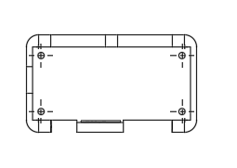
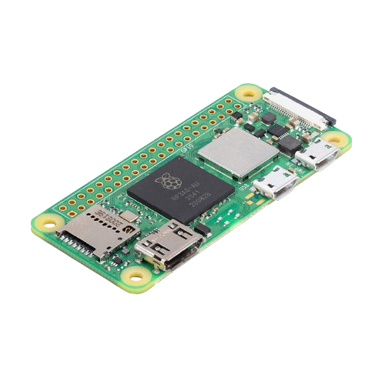
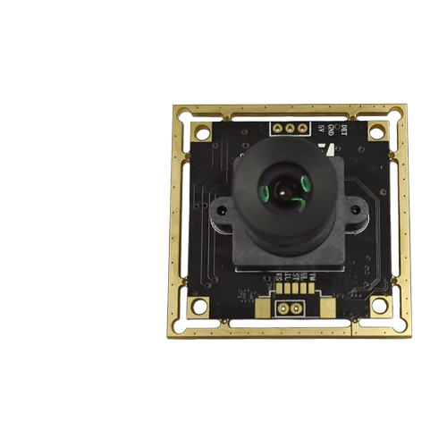
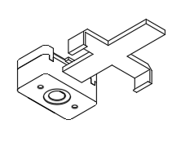
Achievements
Developed full 3D CAD models for the eye-tracking hardware system
Built an early enclosure concept for the Pi + camera assembly
Modeled shell components, ventilation spacing, and cable channels while keeping overall size minimal.
Produced dimensioned drawings for fabrication and iteration
Generated technical drawings of brackets, mounts, and housings to verify measurements and ensure printability.
Developed render-style views to help explain design decisions to Jessica and the research team
Notes:
Jo

Slide 20
Software Research
03
Research & Explorations, Limitations and Conclusion
Notes:
Bev
Thanks Jo for walking us through the hardware prototype component. Now I'll cover our software exploration, which happened in three phases.

Slide 21
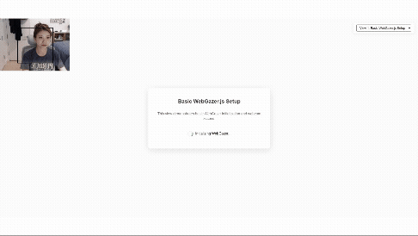
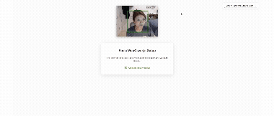
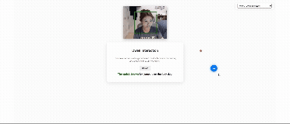
Phase 1: Web-Based Prototype Exploration
Investigated existing eye-gaze frameworks (WebGazer.js, GazeRecorder)
Built browser-based prototype to simulate gaze-interaction behaviors
Key features tested: calibration flow, dwell selection, visual/audio feedback
Outcome: Validated conceptual feasibility and core UX patterns
Notes:
Bev
Phase one: we built a browser-based prototype using WebGazer.js to simulate gaze interaction—calibration, dwell selection, feedback. This validated our core UX patterns and proved conceptual feasibility.

Slide 22

Phase 2: iOS App Development Research
Goal: Develop custom iPhone app with system-wide eye-gaze control and improved calibration
Researched iOS capabilities: TrueDepth camera access, Accessibility APIs, system control permissions
Critical Findings:
iOS sandboxing blocks third-party apps from system-wide control
TrueDepth camera access restricted for privacy/ security
Apple's built-in Eye Tracking (iOS 18+) is the only viable option
Jessica confirmed that Apple's solution is inadequate for her precision needs
Notes:
Bev
Phase two: we researched building a custom iPhone app with system-wide control and improved calibration. But we hit major roadblocks—iOS sandboxing blocks third-party system control, and TrueDepth camera access is heavily restricted. Apple's built-in Eye Tracking seems to be our only option, but Jessica confirmed it doesn't meet her needs when we reached out to her again.

Slide 23
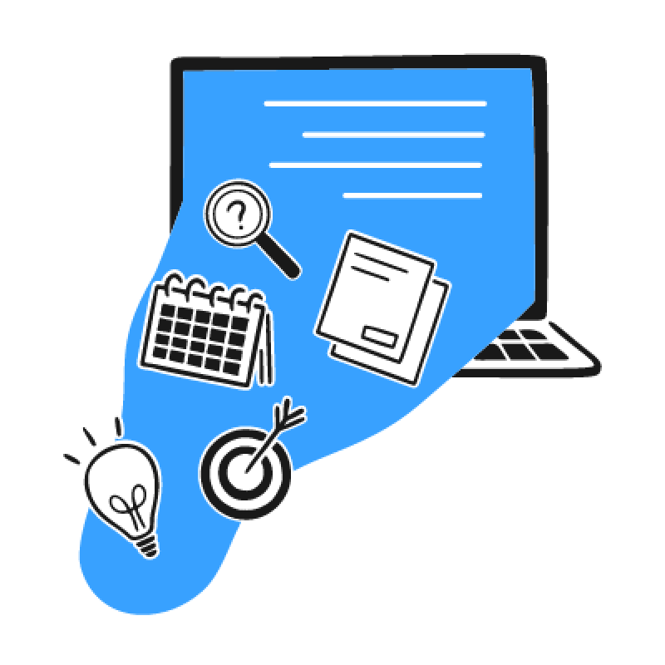
Phase 3: Research Conclusions & Project Direction
Key Finding: Third-party system-wide iOS control is technically impossible
Research Value:
Documented viable vs. non-viable development paths for Jessica
Validated interaction patterns through web prototype
Project Impact:
Software alone cannot solve Jessica's precision needs
Reinforces hardware prototype approach for lighting/precision issues
Directs UX efforts toward optimized interface design (enlarged icons, custom keyboard)
Web prototype demonstrates interaction logic and user flow
Notes:
Bev
This brings us to Phase three, our conclusion: third-party iOS control is technically impossible. But this research was valuable. With it, we documented viable paths for Jessica and validated interaction patterns.
The key takeaway from this is that software alone can't solve her precision needs, which reinforces our hardware prototype approach and directs our focus toward designing a better interface for Jessica. Our web prototype from Phase 1 still remains useful for demonstrating interaction logic.
Yi will now walk you through our iOS app designs and how we optimized them for eye gaze interaction.

Slide 24
iOS App Designs
04
Low Fidelity to High-Fidelity Designs
Notes:
Yi:Thanks Bev. Based on everything we learned from Jessica and our research on accessible app design, we began shaping our iOS app.

Slide 25
Ideation
Design principles
Principle | Meaning | In the UI
Large target size (≥1.6°) | Small icons (<1°) cause fatigue and inaccuracy | Buttons ≥70–80 px, spacing ≥0.5°
High contrast (≥7:1) | Supports low vision & glare environments | Dark background + bright icons
Clear feedback | The user knows what’s selected | Gaze-triggered highlight or zoom
Two-step selection | Prevents accidental clicks | Gaze to highlight → gaze again to confirm
Minimal layers | Avoids complex navigation | Only 3–5 main buttons on home screen
Notes:
Yi: In ideation, we built a design-principles table grounded in Jessica’s concerns and WCAG guidelines. That led us to a few key choices: larger target sizes, high-contrast visuals around seven to one with bright icons on a dark background, and a clear two-step gaze interaction, where users first highlight and then confirm to avoid accidental selections.

Slide 26
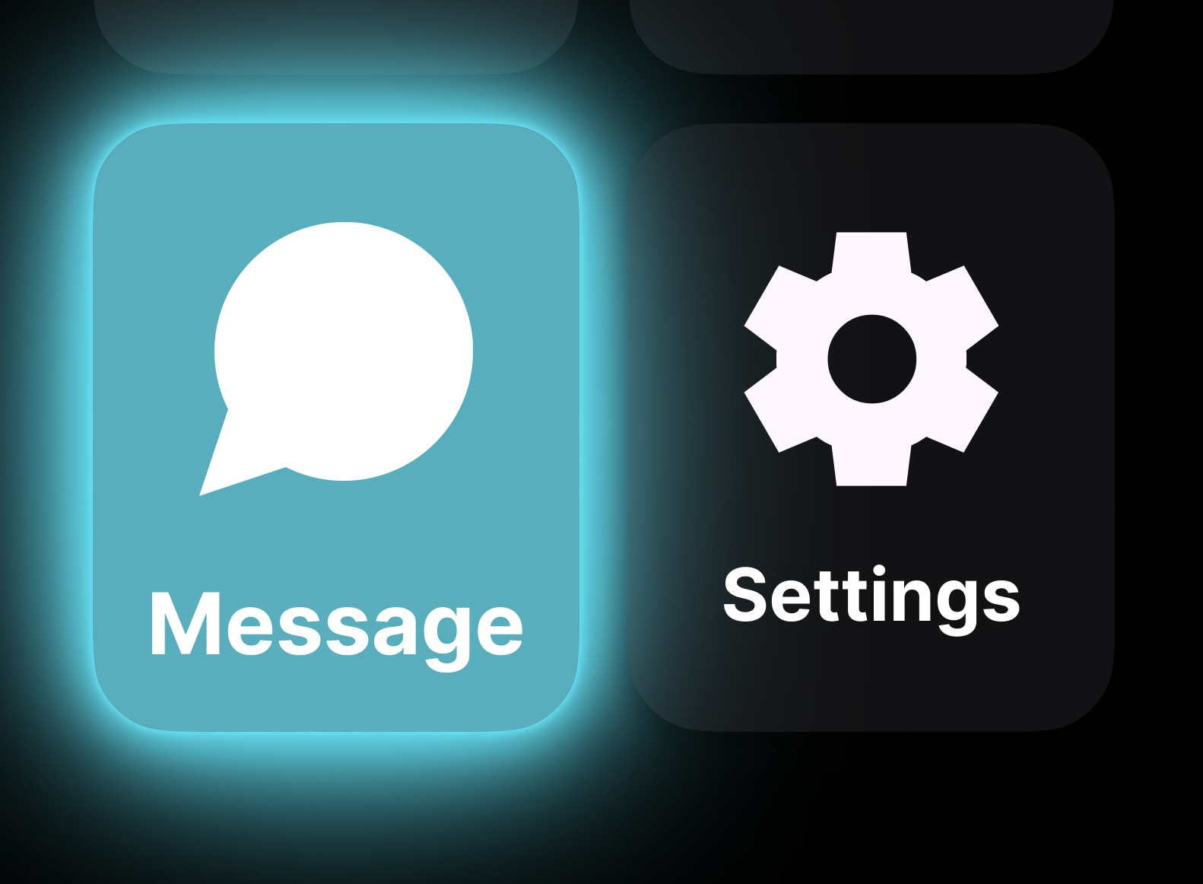
Visual Design
Black Background
Reduces glare and eye fatigue
Strong contrast foundation for accessibility
Keeps visuals clear in bright environments
White Text
Maximum legibility on dark backgrounds
Easily meets WCAG contrast minimum (4.5:1)
Clean and simple for quick reading
Blue Halo (Gaze Feedback)
Meets WCAG non-text contrast (≥3:1)
Accessible for color-vision differences
Blue is intuitive for “focus/active” in iOS
Halo animation adds a second cue beyond color
Color
Notes:
Yi: In visual design, we chose a black background with white text to reduce eye fatigue, especially in bright environments. The blue halo became our gaze indicator because it’s high-contrast, accessible for users with color-vision differences, and already familiar in iOS as a focused state.

Slide 27
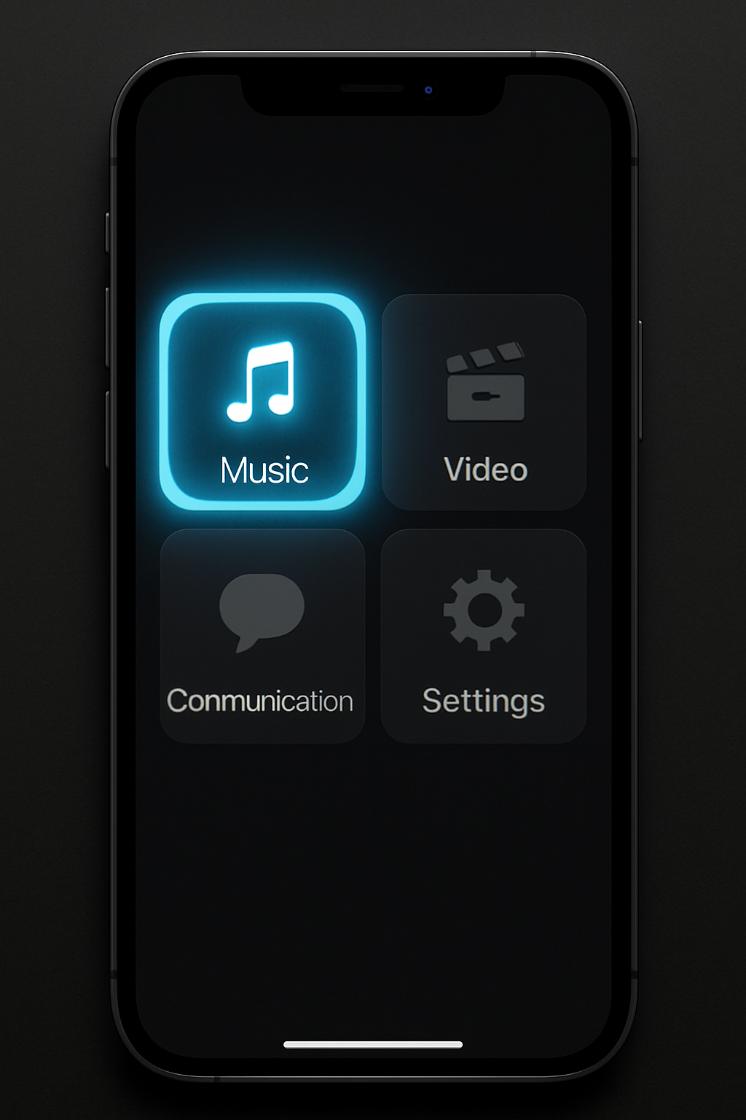
Visual feedback examples
Features
Home Screen: 3–5 large buttons
Assistive Toolbar: Magnifier, contrast switch, pause tracking.
Settings: Adjust dwell time (600–1000 ms), icon size, spacing, color theme.
Feedback & Logs: Show dwell time, errors, and fatigue level (for later tuning).
Gaze state | Visual cue
Start gazing | Soft blue halo appears
Holding gaze | Halo shrinks over 600–1000 ms (countdown)+ Icon enlarges (×1.2)
Rest mode | Dim background or “Take a break” overlay
Notes:
Yi: On this slide, you see how feedback works. A soft blue halo appears when the user begins to gaze, and it gradually shrinks over about a second to confirm the selection.

Slide 28
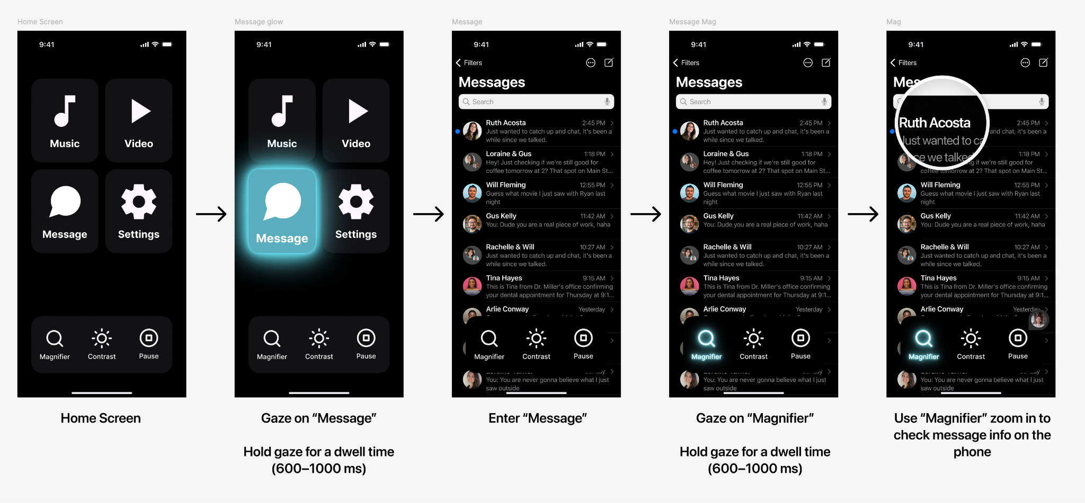
Lo-Fi Prototype
Notes:
Yi: Our lo-fi prototype walks through that flow shown on the slide: gazing at the Message button, entering the inbox, and using the magnifier to zoom into a conversation with enlarged text for easier reading.

Slide 29
User Feedback
Primary Requirements
User: Jessica - Tobii Eye Gaze quadriplegia user
Priority: Accuracy above all elseDevice: iPhone with eye tracking capability
Core Features Needed
Keyboard communication board
Dedicated storage area for:
Words
Sentences
Paragraphs
“All I care about is the accuracy.”
Notes:
Yi: When we shared this with Jessica, she emphasized how much she depends on symbol boards, keyboard boards, and saved phrases.

Slide 30
Final Prototype
Notes:
Yi: In our final prototype, you can see that reflected in the typing experience, you’ll see in the video.

Slide 31
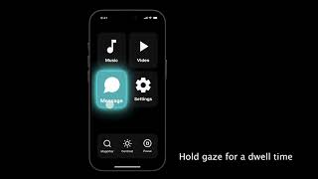
Notes:
Yi: Now, I’m moving to Jo for the next steps

Slide 32
Next Steps
05
Recommendations and What’s Next?
Notes:
Jo

Slide 33
⭐⭐⭐⭐⭐
Develop calibration + full gaze-mapping model
Add IR illumination for stable performance
Redesign enclosure for wearable form factor
Improve algorithm accuracy + speed
Conduct structured user testing
Build multi-environment eye dataset
Explore real interaction tasks
Document and prepare project for open-sourcing
Notes:
Jo

Slide 34
THANK YOU
Notes:
Jo

Slide 35
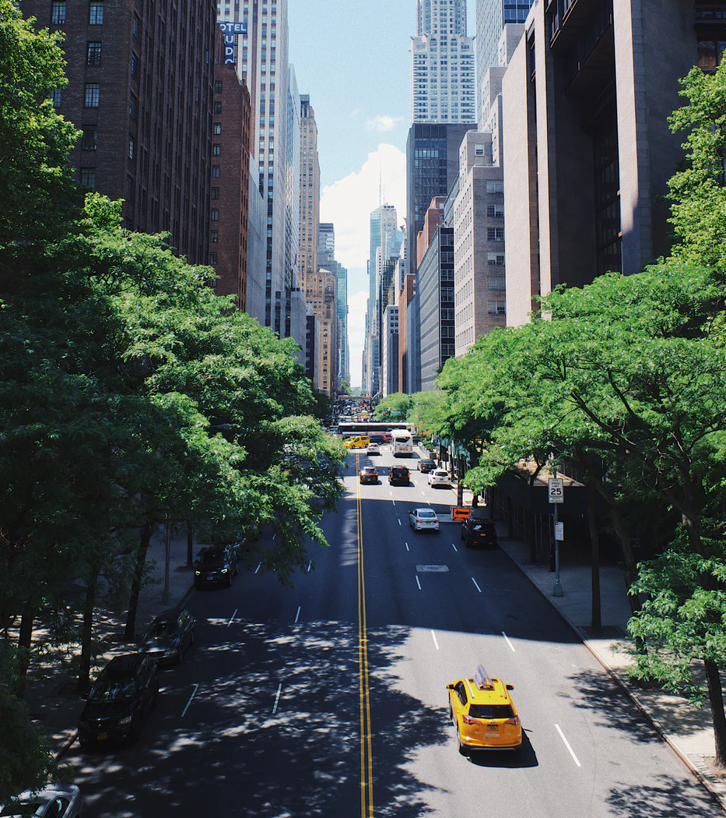
References
https://www.tobii.com
https://www.smarteye.se/
https://varjo.com
https://nova-sight.com/
https://www.ovt.com/
https://imotions.com/
https://grabcad.com/library/sony-imx258-camera-module-1
Khan MQ, Lee S. Gaze and Eye Tracking: Techniques and Applications in ADAS. Sensors (Basel). 2019 Dec 14;19(24):5540. doi: 10.3390/s19245540. PMID: 31847432; PMCID: PMC6960643.
Notes:
Jo
UPDATE

Slide 36
TITLE
HERE
Since its founding in 1831, NYU has been an innovator in higher education, reaching out to an emerging middle class, embracing an urban identity and professional focus, and promoting a global vision that informs its 19 schools and colleges.

Slide 37
OUR HISTORY IN
TWO PARAGRAPHS
Since its founding in 1831, NYU has been an innovator in higher education, reaching out to an emerging middle class, embracing an urban identity and professional focus, and promoting a global vision that informs its 19 schools and colleges.
Today, that trailblazing spirit makes NYU one of the most prominent and respected research universities in the world, featuring top-ranked academic programs and accepting fewer than one-in-five undergraduates.

Slide 38
TITLE ONLY SLIDE

Slide 39
AN IMPORTANT
QUOTE BELONGS
ON THIS PAGE.

Slide 40
SLIDE WITH LIST ITEMS
First Item
New York University has grown into one of the nation's leading institutions of higher ed
Second Item
New York University has grown into one of the nation's leading institutions of higher ed
Third Item
New York University has grown into one of the nation's leading institutions of higher ed

Slide 41
SLIDE WITH SMALL TITLE
Since its founding in 1831, NYU has been an innovator in higher education, reaching out to an emerging middle class, embracing an urban identity and professional focus, and promoting a global vision that informs its 19 schools and colleges.

Slide 42
SLIDE WITH IMAGE
Today, that trailblazing spirit makes NYU one of the most prominent and respected research universities in the world, featuring top-ranked academic programs and accepting fewer than one-in-five undergraduates.

Slide 43
Click to add caption

Slide 44
SOME QUOTES
DESERVE TO BE
LARGER THAN
LIFE ITSELF.

Slide 45
100%
INCREASE SINCE 2010
Today, that trailblazing spirit makes NYU one of the most prominent and respected research universities in the world.

Slide 46
TEMPLATE NOTES
This template is part of the NYU Templates collection. Refer to our Usage Guidelines for help topics and quick tips on how to use this template.
Download the Grackle Slides add-on to automatically run accessibility checks on all aspects of your document and get advice on how to make things better.

